Slide 1

Re-Loop
Solving the First-Mile Collection Problem for Household E-Waste via Gamified Reverse Logistics.

Slide 2
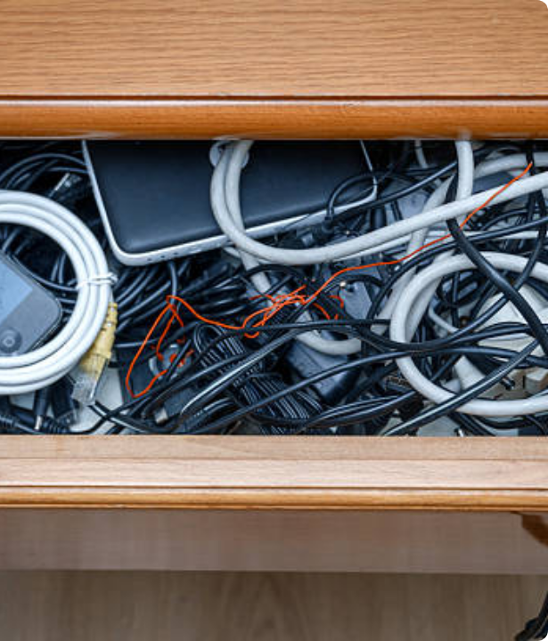
The "Drawer of Doom"
Trapped Value
Millions of tons of valuable e-waste are trapped in our homes simply because driving to a specialized recycling center presents too much friction.
Old smartphones, tangled cables, and dead chargers sit indefinitely in drawers, representing a massive loss of recoverable commodities and an environmental hazard.

Slide 3
The Core Bottleneck
The Infrastructure Exists
0%
The waste exists in abundance, and the recycling infrastructure is ready to process it. The critical failure point is the first-mile collection.
By relying entirely on consumer goodwill and proactive transport to distant facilities, the current model guarantees failure, especially for low-weight micro-electronics.
Consumer Initiative Success

Slide 4








The Solution: Reverse Gig Logistics
1. Easy Listing
2. Hyperlocal Pickup
3. Instant Rewards
Users open the app, snap a quick photo of their tangled cables, dead chargers, or old phones, and instantly request a pickup directly from their doorstep.
Gig workers (e.g., delivery drivers returning from a drop-off) are algorithmically routed to pick up the bag of electronics, removing all friction for the user.
Instead of paying for pickup, users earn digital cash, sustainability points, or brand discount coupons, gamifying the recycling process.

Slide 5
Robust Revenue Strategy
Unlocking immense value from household e-waste through a diversified, highly scalable monetization engine.

Slide 6


Dual Revenue Streams
1. Bulk Material Scrap
2. B2B EPR Compliance
We aggregate thousands of small, low-value individual pickups into massive, high-value tons of copper, plastic, and circuit boards.
Hardware brands are legally mandated to fund e-waste recycling through Extended Producer Responsibility (EPR) regulations.
By achieving this scale, we can bypass middlemen and sell these aggregated materials directly to certified, large-scale refineries at premium commodity rates.
We charge mid-to-large consumer tech brands a premium fee to verifiably collect and recycle e-waste on their behalf, helping them easily meet strict government targets.

Slide 7
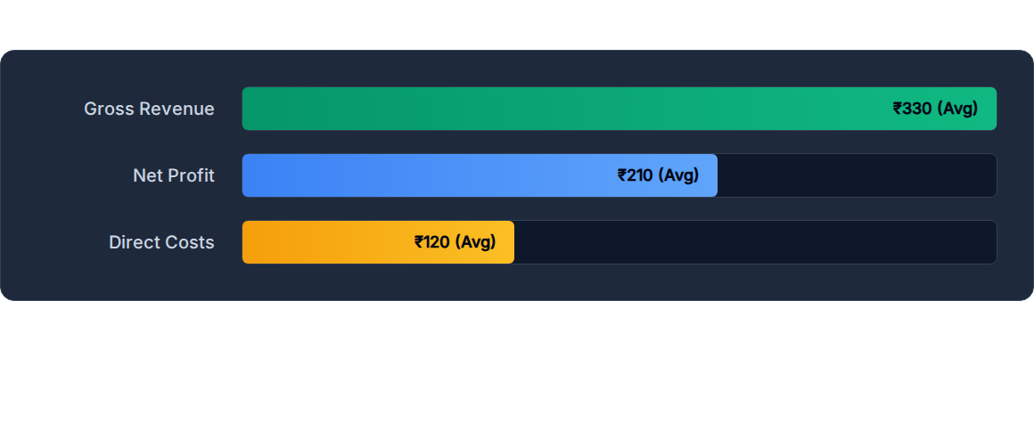
Financial Breakdown (Per Pickup)
Based on our financial models, Gross Revenue (from scrap + EPR fees) ranges from ₹240-420, while Direct Costs (driver payouts + rewards) run ₹100-140, leaving a highly healthy profit per unit.

Slide 8
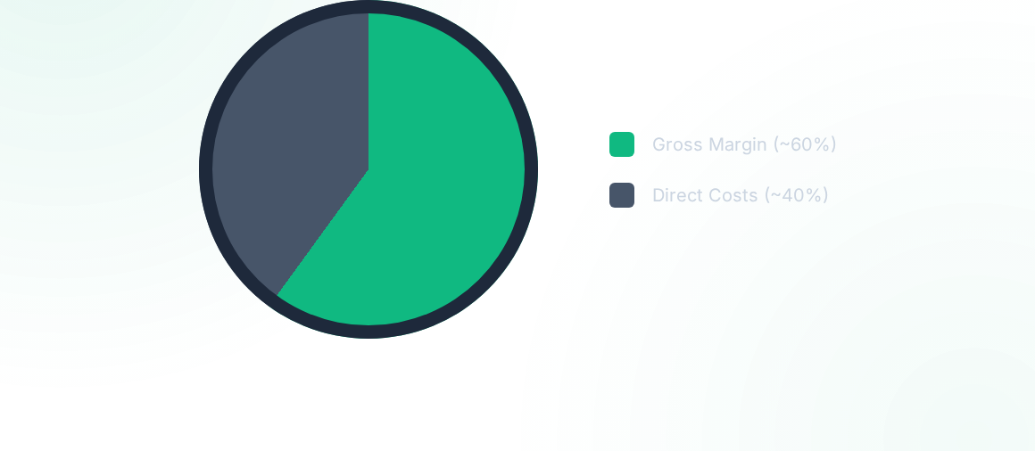
Highly Profitable Unit Economics
By reaching city-scale density of 12,000 pickups per month, the operational model projects a ₹30L - ₹50L Net Profit in Year 1 alone.

Slide 9

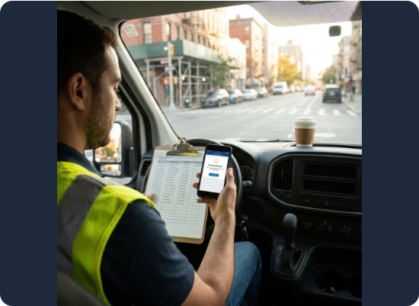
Minor Operational Requirements
To support this high-margin revenue model, Re-Loop requires the following fundamental operational pillars:
API Integrations: Seamless connection with existing gig economy platforms to efficiently route drivers for hyperlocal pickups.
Basic Sorting Hubs: Centralized, low-cost facilities for aggregating and loosely categorizing household e-waste before refinery transport.
EPR Tracking Software: A verifiable reporting dashboard to prove collection metrics to our B2B hardware brand clients.
Refinery Partnerships: Pre-negotiated contracts with certified recyclers to guarantee premium commodity purchase rates.

